Slide 1
Chapter 10_2 Light In the medical
Dr rafid albadr |

Slide 2
Laser
A laser (Light Amplification by Stimulated Emission of Radiation) is an optical source that emits photon in a coherent beam.
Light Amplification by Stimulated Emission of Radiation.
Light: All light is a form of electromagnetic radiation that is visible to the human eye.
Amplification: This is simply the process of making something bigger or more powerful. When you turn up the volume on a radio, you are amplifying the sound; but with lasers, amplification makes the light brighter.
Stimulated: To stimulate means to stir to action. Laser light is created when a burst of light (electricity) excites the atoms in the laser to emit photons. These photons then stimulate the creation of additional identical photons to produce the bright laser light.
Emission: The word "emission" refers to something that is sent out or given off. Stimulated laser emission consists of large numbers of photons that create the intense laser light.
Radiation: The laser light is a form of energy that radiates, or moves out, from the laser source

Slide 3
Laser- Properties of LASER:
Monochromatic The light emitted from a laser is monochromatic, it is of one wavelength (color).
In contrast, ordinary white light is a combination of many different wavelengths (colors).
Directional Lasers emit light that is highly directional.
Coherence.
Coherent waves are waves that maintain the relative phase between them .
y = A cos (wt+f)
A = Amplitude . w = Angular Frequency . f = Initial Phase of the wave (Describe the starting point in time of the oscillation). (wt+f =) Phase of the wave.

Slide 4
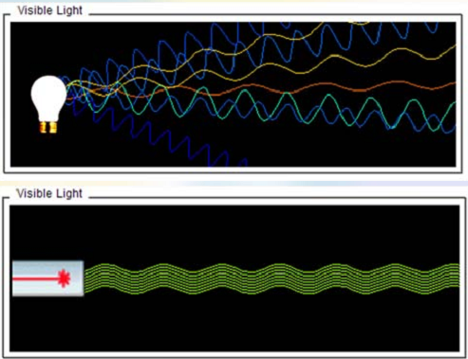
Laser- Properties of LASER:

Slide 5
Physics of eye and vision
General structure of the eye : the human eye is a adjustable lens system consisting out of two focusing elements and a light receptor system.
The cornea is the main focusing element with a front radius R
Material has fairly high index of refraction N = 1.37 which favors refractive focusing from the low index of refraction of air n=1
The length of the eyeball is approximately 24 mm, so the distances from the cornea/crystalline lens to the retina and the focal length of optical rays focused by the cornea/crystalline lens propagating in the vitreous humor and imaging on the retina, are also about 24 mm. The refractive index of the vitreous humor is approximately 1.33.

Slide 6
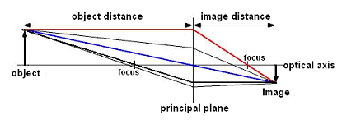
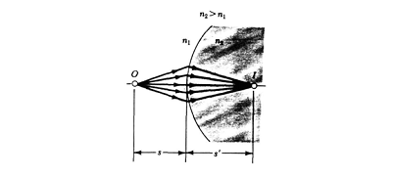
Physics of eye and vision
$∅=\frac{1}{f}=\frac{1}{d_{object}}+\frac{1}{d_{image}}$
Where d is distance and φ lens power. It holds for thin lenses

Slide 7
Physics of eye and vision
Example A concave mirror has a radius of curvature of 25 cm. A 2 cm tall object is placed 20 cm from the mirror along its axis. Find the location of the image .
Solution: Using
d object=20 cm and f =R/2=12.5 cm and solving the mirror equation for the image distance gives
$$\frac{1}{d_{image}}=\frac{1}{d_{object}}−\frac{1}{f}$$
$$\frac{1}{d_{image}}=\frac{1}{20}−\frac{1}{12.5}=0.03 {cm}^{−1} so d_{image}=33.3 cm$$

Slide 8
Physics of eye and vision

Slide 9
Physics of eye and vision

Slide 10
Physics of eye and vision

